Slide 1



Slide 2


St Joseph’s Boys’ High School

Slide 3
ABOUT SJBHS
St. Joseph's Boys' High School is known for its excellent academics, stupendous sporting achievements, engaging fests and various extracurricular activities. The school strongly believes in the ideology of building a hard-working, compassionate and responsible student community; true to its belief, it has over the years, shaped and broadened the intellectual and emotional horizon of the students.
Notwithstanding the fact that the current pandemic has posed a challenge to normal existence and sabotaged the creative world of the student community, SJBHS, with iron determination, desires to turn this adversity into opportunity by organizing its second virtual Model United Nations.
With a deep sense of pride, we present to you, the 9th annual edition of the St. Joseph's Boys' High School Model United Nations.

Slide 4
ABOUT SJBHS MUN
22nd - 24th OCTOBER
SJBHS MUN is the annual Model United Nations conducted by St. Joseph’s Boys’ High School. It encourages and provides students with a platform for deliberation, discussion and co-operation. The delegates must grapple with a diverse range of geo-political and socio-political issues that not only play a significant role in what we understand as modern-day society, but also shape future societal norms.
SJBHSMUN has been a breeding ground for proficient MUNners for the past nine years and is one of the oldest and most prestigious conferences to be hosted in the country. SJBHS prides itself in incorporating the Jesuit values of a 163-year-old institution in every event that it hosts. SJBHS aims to foster an environment of peace, harmony and mutual growth amongst delegates as they aim to tackle the world’s most pressing issues. We proudly present to you, the 9th annual edition of the St. Joseph's Boys' High School Model United Nations.
As always, delegates, ‘The power is yours!’

Slide 5

LETTER FROM THE SECRETARY GENERAL
4

Slide 6
LETTER FROM THE SECRETARY GENERAL
At the outset, I do not present a preferable quote that details the undertone of my message. However, my intent is to speak to those who aspire to change and use their voice as an authority for change in this war-torn and conflicted era. The idea of MUNs conceptualized a platform where influential and future generations could rationally argue and logically solve conflicts and issues that threaten geopolitical safety. Man has always been in conflict, be it internalized or external. We are a generation that reap the seeds sown by our forefathers that left us with an idea for peace but a land for torture. A MUN follows with a purpose – that your individual presence as a diplomat of a nation would aspire for peace and advocate for change.
My name is Nikhil Anand and I am an alumnus of St. Joseph’s Boys’ High School. The activity of MUNning has existed for over a decade. I have played but a small part in its role of shaping future potential leaders and ambassadors of resolve. It has brought about a stage where individual talent would be entrusted with powers. A power to act on behalf of countries to balance the scales of promoting national agendas with international peace and security. I have spent the entirety of my life in school nurtured by this institution that now hosts another edition of SJBHSMUN, 2021.
While most conflicts divide us by ideology and opinion, the pandemic of today serves a different purpose. We are isolated in the walls of our homes but still engaging in virtual battles of law and order. If anything, the pandemic has done what most conflicts failed to achieve i.e. to align us to cooperate and coordinate efforts.
SJBHS MUN has been a centre for competitive debates and an exceptional platform for students to voice their opinions and display talent in an environment that demands nothing less than excellence and perfection. The task of MUNing is not easy – one has to protect national interests whilst simultaneously allying other nations and coordinating efforts to reach amicable solutions in situations of conflict. Use your voice as a means to your end, speak because you play a part in resolving or destroying the peace of tomorrow. Listen to your fellow competitors and consume their knowledge as a weapon to your own. You hold within your hands the power of an entire nation. While you are here to negotiate and debate, you are also here to win and succeed.
I am proud to serve as the Secretary General of SJBHSMUN 2021. I wish you the best of luck and hope your purpose is served.
5

Slide 7

6

Slide 8
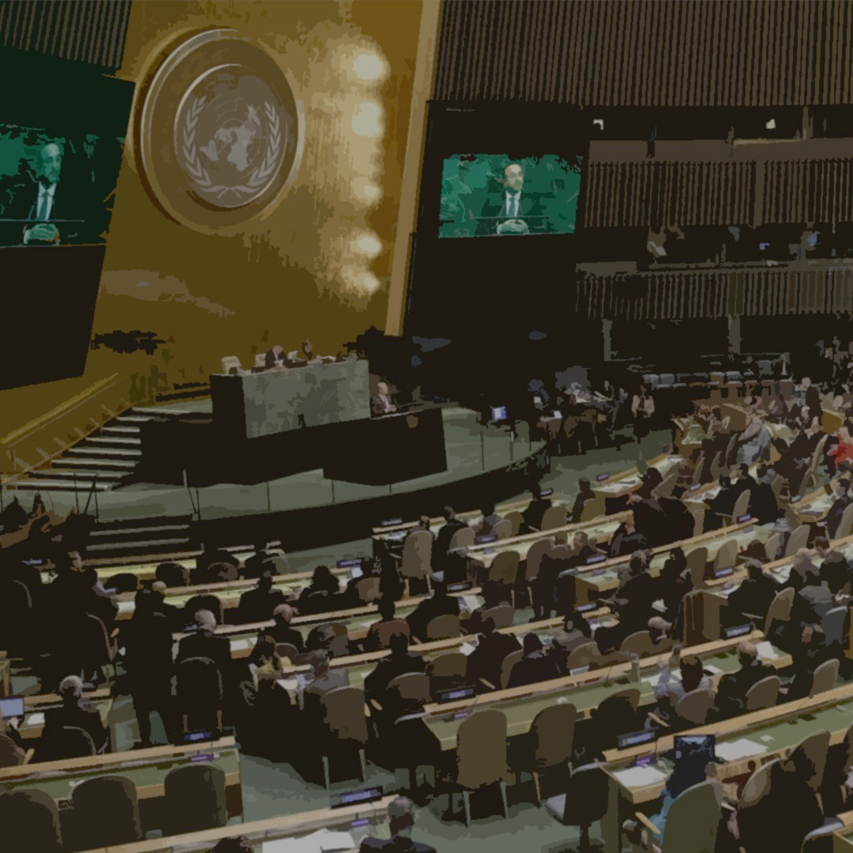

SPECPOL
7

Slide 9
Special Political and Decolonization Committee
AGENDA
Discussing the right to self-determination, with special reference to non-self-governing territories.
“Act only according to that maxim by which you can at the same time will that it should become a universal law.” ~ Immanuel Kant
SPECPOL is the Fourth Committee of the General Assembly. SPECPOL involves the discussion of a wide range of topics from human rights to outer space. The delegates, at this meeting, will discuss non-self- governing territories. The Committee aims at making these territories aware of their rights and also aim at helping them reach self-determination. The UN has been successful in decolonising more than 80 countries as sovereign and independent countries. But there are still 17 non-self-governing territories, even after the Trusteeship Council achieved its goals, that have not been able to exercise their right to self-determination. The long-standing predicament of self-determination and self-governance, as old as the era of colonialism, still remains unsolved. Even in the modern age of diplomacy, a multitude of questions remain with regard to the sovereignty of multiple territories such as autonomy for Catalonia or freedom for Hong Kong.
This committee will be tasked with developing effective strategies to counter the ever more alarming global issue of self-determination through the evolution of Geo-politics and International Law.
8

Slide 10
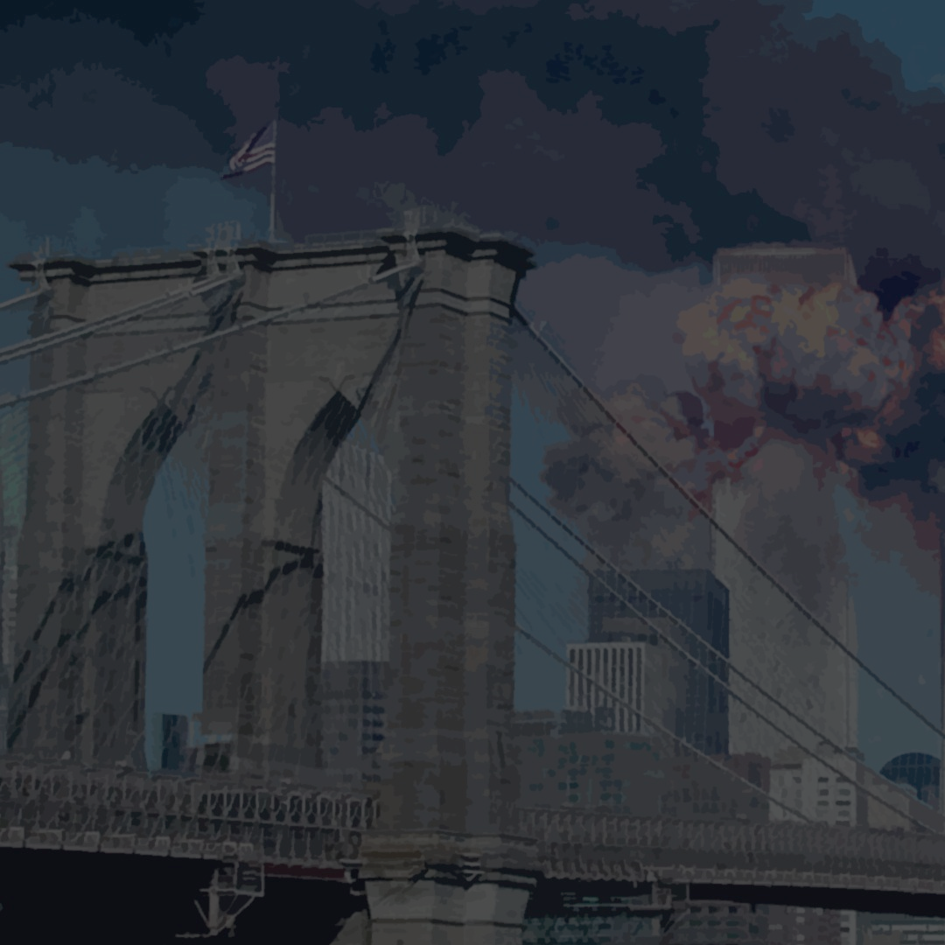

HSC
9

Slide 11
Historic Security Council
AGENDA
Discussing the rise of religious fundamentalism with special reference to Islamic radicalization.
“The plain truth is the day is coming when no single nation, however powerful, can undertake by itself to keep the peace outside its own borders.” ~ Robert S. McNamara
The Security Council is the most important organ of the UN by virtue of the fact that it can pass binding resolutions on member states. The presence of the veto, however, complicates this power and makes passing any decision of value difficult. Terrorism has gone from a persistent yet marginal security concern to one of the most pressing problems of today. Though many terror attacks are foiled, some groups wage lengthy and bloody campaigns, and massacre thousands with scant respect for human life. The fate of the world hangs on the decisions made by the delegates. In the face of the impending crisis, we have set the stage for YOU to save the world from the abyss of darkness it writhes in. The cost of inaction is too hefty a cost to be borne by humanity. The price of action brings to reality what might be morally permissible, under the circumstances. This will reflect on the virtues and vices of the global community. But then, delegates, are YOU ready to show the world what results your actions truly bring about? Are you truly that different from your foes? FREEZE DATE: January 5th, 2000. This committee will follow an accelerated timeline NOTE: This is a Crisis Committee

Slide 12
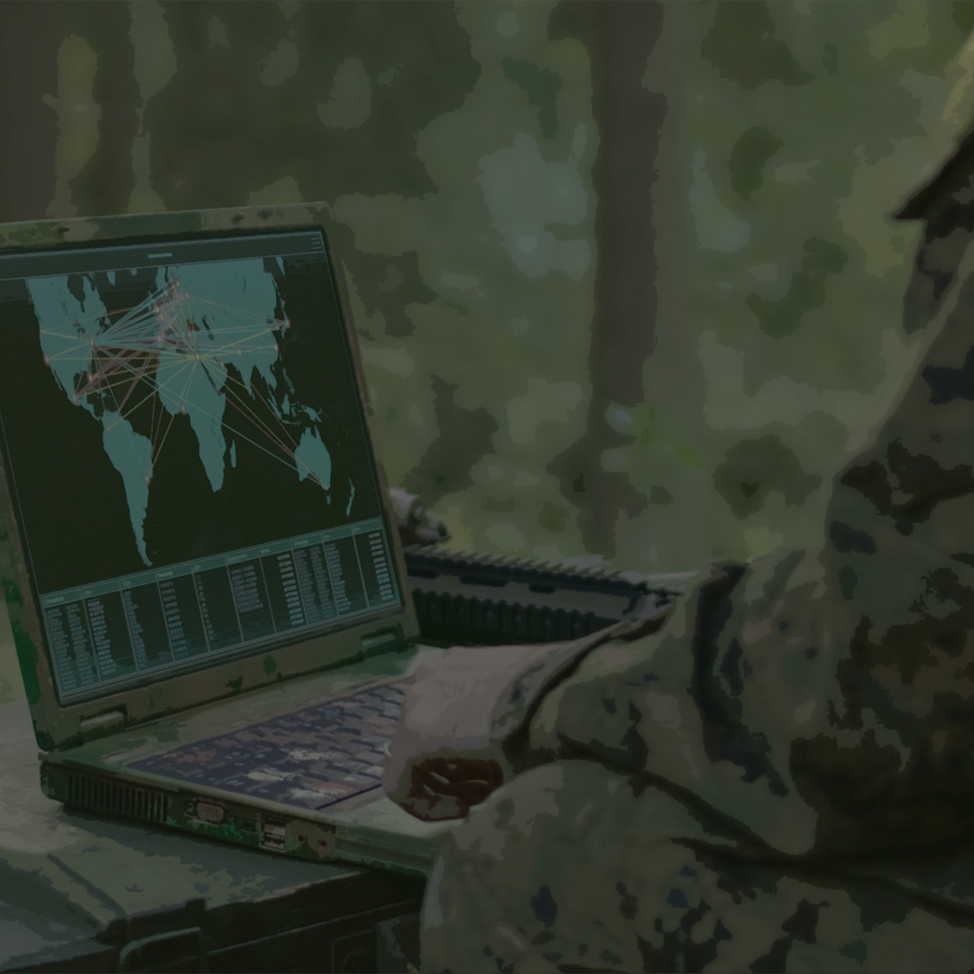

INTERPOL
11

Slide 13
The International Criminal Police Organization
AGENDA
Creating a framework to combat the threats posed by 5th generation warfare with special reference to non-state actors and state-sponsored entities.
“The nation is burdened with the heavy curse on those who come afterwards. The generation before us was inspired by activism and a naive enthusiasm, which we cannot rekindle, because we confront tasks of a different kind from those which our fathers faced.” ~ Max Weber
Interpol was set up as a policing organisation with global jurisdiction in 1914, with the aim of working together with law enforcement agencies across the world to prevent and solve crime. Fast forward a century later and no one could have ever predicted the advances in technology, let alone policing technology. This has also brought along the threat of fifth-generation warfare. This can be conducted through multiple means, such as social engineering, misinformation, cyberattacks, etc. While the earlier generations of warfare relied on the might of military, speed, stealth, and surprise, in this modern warfare the lines between war and politics, military and civilian are blurred, leaving the world as a constant warzone.
The burgeoning digitalization of the world only intensifies the threat of 5th generation warfare. Whether it is a gas pipeline shutdown or a sensitive data hack, one can only imagine the damage a belligerent nation with the latest technology can inflict upon the world. Where patience is vital and time is the most valuable armour, do you, delegates, have what it takes to engage in a ‘war of perceptions?’ When the stakes are high and the focus is on shaping perceptions rather than strengthening defence, can you defy the threats posed by identity politics, misinformation and the rise of insurgencies to emerge victorious?
12

Slide 14
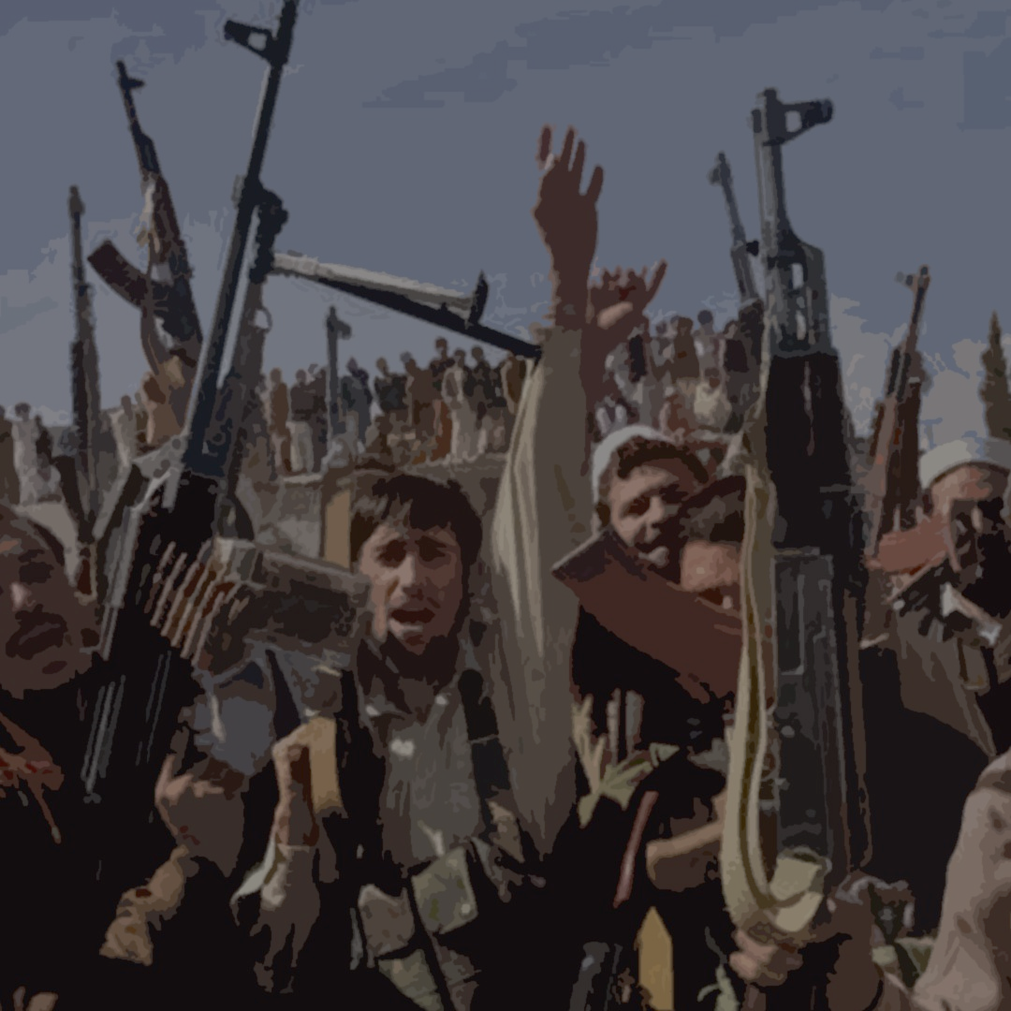

KLAQS
13

Slide 15
Kuala Lumpur Al-Qaeda Summit
AGENDA
Discussing the future of religious fundamentalism.
“Extremism in the defence of liberty is no vice. Moderation in the pursuit of justice is no virtue” ~ Senator Barry Goldwater
An eerie silence envelopes the deepest realms of various Global Actors ever since the success in Kenya and Tanzania and our outreach has subsided. But our chants have taken new faces and our voices have only grown.
Chatter has begun amidst the intelligence community for a meeting that is set to take place in Kuala Lumpur, Malaysia from the 5th of January, 2000. Attendees include veterans of the Soviet-Afghan war and some suspected fundamentalists. The outcome of this meeting will be decided solely by the delegates and their actions. So, gear up delegates, for YOU have the power to change global power dynamics as we know it. Delegates will be put in the shoes of various global non-state actors and will be tasked with the objective of achieving a common global goal. Do what it takes to spread the ideals of your philosophy while making sure you bring about a change in the global power dynamics. FREEZE DATE: January 5th, 2000. This committee will follow an accelerated timeline NOTE: This is a Continuous Crisis Committee (CCC)

Slide 16
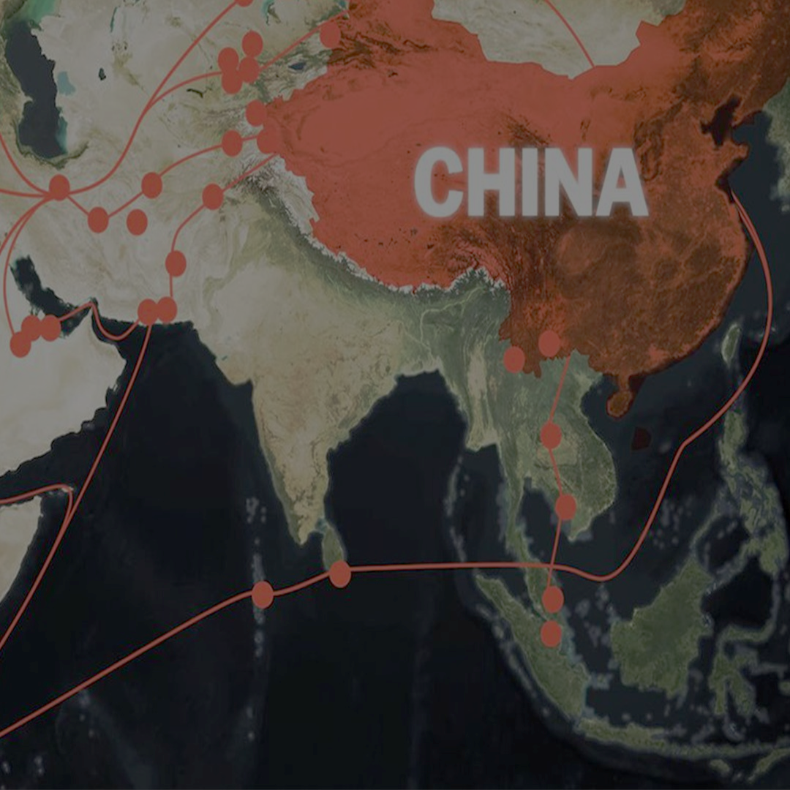

LOK SABHA
15

Slide 17
Lok Sabha
AGENDA
Countering China's influence in the Indo-Pacific region.
“Politicians are the same all over. They promise to build a bridge even where there is no river” ~ Nikita S. Khruschev
A major pandemic may have brought attention to China’s disregard for public safety but that does not shine a light on the actual threat posed to the current geopolitical status-quo. China’s aggressive expansionist policy, whether it be in the economic front or the military front, can be perfectly demonstrated in the Indo-Pacific region. The age-old issue of control over the South China Sea seemed to be getting closer to a resolution in the previous decade, not through multilateral agreements by the involved parties, but by China asserting military control over a large region of the sea. This controversy also foreshadows other ventures such as the Gwadar Port Project and the One Belt-One Road Project with the aim of asserting hegemony over its neighbours. With India’s sphere of influence being encroached upon, time is of the essence to pass legislation to combat the impending threat. The responsibility now lies on the members of India’s lower house of the Parliament to bolster India’s global position. The situation is further complicated by the recent defence and ‘cooperation’ deals signed between China and India’s immediate neighbours. All this considered, the delegate representing a member of Parliament is tasked with devising, deliberating and passing comprehensive laws to stem China’s expansion into the Indo-Pacific region. Can you, as a member of Parliament, secure the required support to get your agenda passed?
16

Slide 18

RULES &
REGULATIONS
17

Slide 19
General Rules & Regulations
SJBHSMUN is open to all students up to first year in their respective undergraduate courses.
All delegates must attend the conference using laptops with a working camera and microphone. Virtual backgrounds of any sort are prohibited.
The dress code is western formals. Indian formals are permitted for the delegates of the Lok Sabha.
The prize money mentioned on the website is subject to change.

Slide 20
Rules with Regard to Registrations
The registration fee is to be paid within 48 hours after receiving the confirmation email. A payment link shall be sent for the same.
After the payment to the account mentioned in the confirmation email is made, a screenshot/ confirmation of the same must be sent to mun@sjbhs.edu.in.
In case of cancellation after payment, refunds shall be allowed up to 2 days prior to the MUN.
Registrations shall be made on a first come-first serve basis.
Kindly ensure that the phone number submitted at the time of registration is a WhatsApp number.
A valid ID proof (school ID, Aadhar Cards etc.) must be submitted at the time of registration. The photo must be clear and visible.

Slide 21
Committee Rules
The conference will be held on the ZOOM platform.
Delegates are required to join the zoom link 20 minutes prior to the commencement of the session.
The participants are required to rename themselves as follows – (Country/portfolio – individual name).
Any participant failing to join on time will be required to give an explanation for the same to the EB members.
The chat option on the ZOOM platform shall be open for direct communication. Delegates can make use of the same, keeping in mind the Anti-harassment Policy.
All grievances can be mailed to mun@sjbhs.edu.in or a message can be sent to the student coordinators.

Slide 22
Committee Rules
No vulgarity or inappropriate language/gestures will be tolerated.
The decision of the Executive Board Members is final.
There must be AT LEAST 1 executive board member on each of the WhatsApp groups of respective bloc groups. This is with respect to the marking of the delegates.
The delegates are requested to upload the profile picture of the respective country/portfolio as their display picture on zoom. The same shall be forwarded to them after the payment is made.
We expect the active cooperation of everyone to make SJBHSMUN a memorable experience for all.

Slide 23
SCHEDULE
22

Slide 24
DATE | TIMING | SESSION
DAY 1 | 1:30 p.m. - 3:30 p.m. | Session 1
22nd October | 3:30 p.m. - 4:00 p.m. | Break
 | 4:00 p.m. - 6:30 p.m. | Session 2
DAY 2 | 10:00 a.m. - 12:00 p.m. | Session 3
23rd October | 12:00 p.m. - 12:30 p.m. | Break
 | 12:30 p.m. - 2:30 p.m. | Session 4
 | 2:30 p.m. - 3:15 p.m. | Break
 | 3:15 p.m. - 4:45 p.m. | Session 5
 | 4:45 p.m. - 5:00 p.m. | Break
 | 5:00 p.m. - 6:30 p.m. | Session 6
DAY 3 | 10:00 a.m. - 12:00 p.m. | Session 7
24th October | 12:00 p.m. - 12:30 p.m. | Break
 | 12:30 p.m. - 3:00 p.m. | Session 8
 | 4:00 p.m. | Closing Ceremony

Slide 25
REGISTER
PRIZES
BEST DELEGATION* | ₹7500
BEST DELEGATE | ₹4000
HONORABLE DELEGATE | ₹2000
COMMENDABLE DELEGATE | ₹1000
REGISTRATION FEE
DELEGATE | ₹250
DELEGATION (5 DELEGATES) | ₹1250
CLICK HERE TO REGISTER
*To qualify for Best Delegation, a delegate from the delegation must be present in each committee.

Slide 26
CONTACT US
Feel free to contact us regarding any issue. Don’t hesitate to get in touch!
STUDENT CONTACTS
SANIA SABU | +91 96204 20581
DULCINA MISQUITH | +91 6363 755 348
TEACHER COORDINATOR
Mrs. HEMAVATHY | +91 98804 32300
SOCIALS
Website: | https://sjbhs.edu.in/sjbhsmun
Email: | mun@sjbhs.edu.in
INSTAGRAM | @sjbhsmun
25

